Slide 1
RNA-seq pipeline analysis using R
ch07_RNAseq_pt1 : Processing raw RNAseq data
221102

Slide 2
RNA sequencing workflow: Overview
Samples of interest
Total RNA extraction
Data analysis - Differential expression analysis - Variant calling - Novel transcript discovery
Enrichment of target RNA (polyA, rRNA depletion)
cDNA library building (fragment, RT, ligate adapters, amplify)
Sequencing
Mapping (genome or transcriptome)
Experiment design
Experimental part
Outsourced part
Bioinformatics part

Slide 3
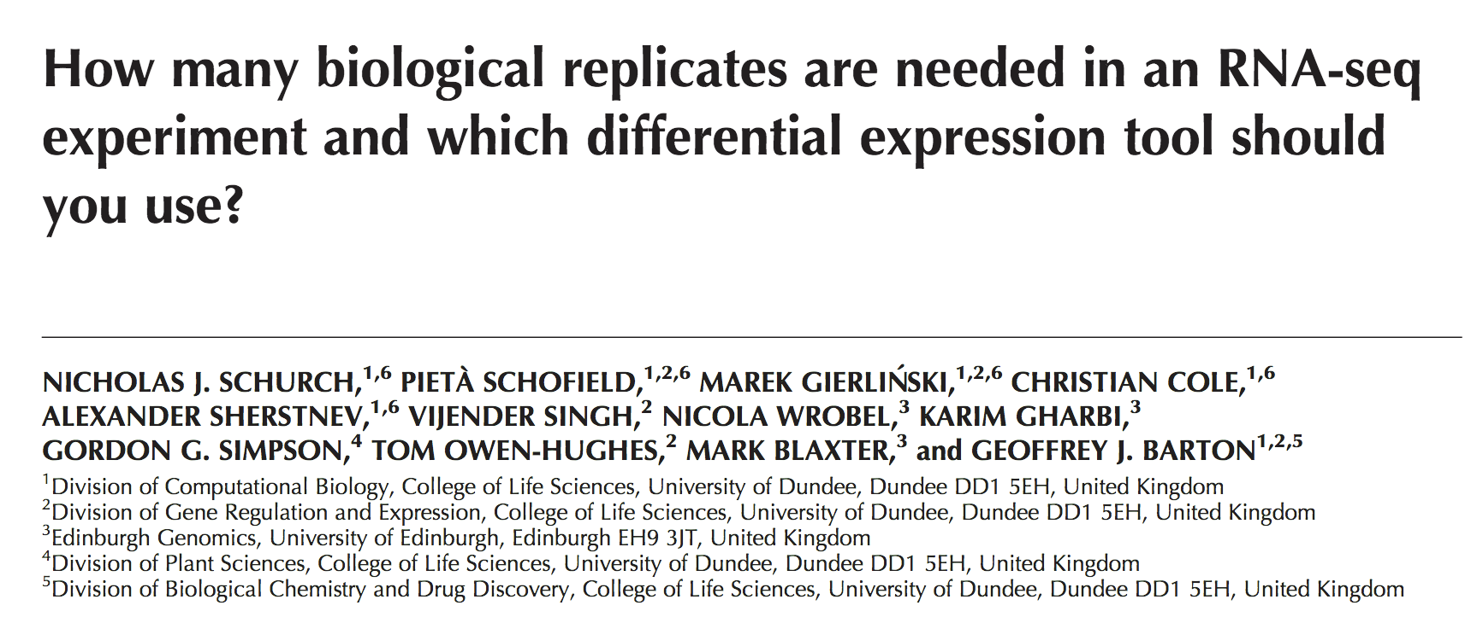
Experimental design
To be adjusted and focused to answer what you are testing for
Things to take into account
Batch effects
Technical replicates make your analyses stronger but biological replicates make it trustworthy
For most statistical tests, at least 3 biological replicates are needed
Depth of sequencing
Notes:
In the context of discovery (exploratory RNAseq), there is a trade off between sample replicates and depth of sequencing
Increasing the number of reads might seem beneficial but if most of the reads come from a pool of a few highly expressed genes, you might be better off increasing the size of the sample pool

Slide 4
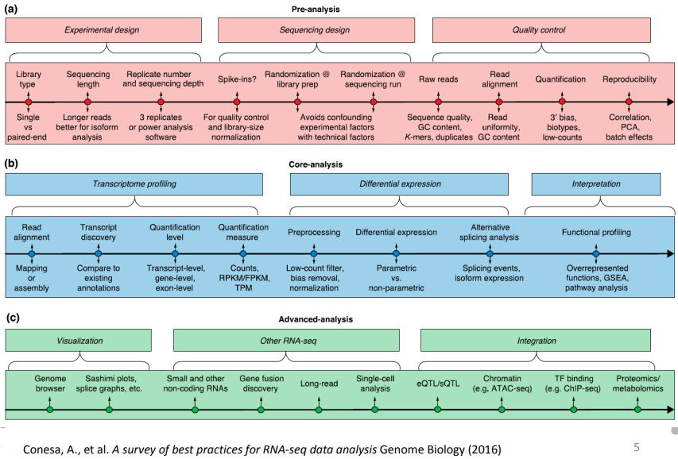
Experimental design
Notes:
In the context of discovery (exploratory RNAseq), there is a trade off between sample replicates and depth of sequencing
Increasing the number of reads might seem beneficial but if most of the reads come from a pool of a few highly expressed genes, you might be better off increasing the size of the sample pool

Slide 5


RNA sequencing workflow: Overview
Samples of interest
Total RNA extraction
Data analysis - Differential expression analysis - Variant calling - Novel transcript discovery
Enrichment of target RNA (polyA, rRNA depletion)
cDNA library building (fragment, RT, ligate adapters, amplify)
Sequencing
Mapping (genome or transcriptome)
Experiment design
Experimental part
Outsourced part
Bioinformatics part

Slide 6
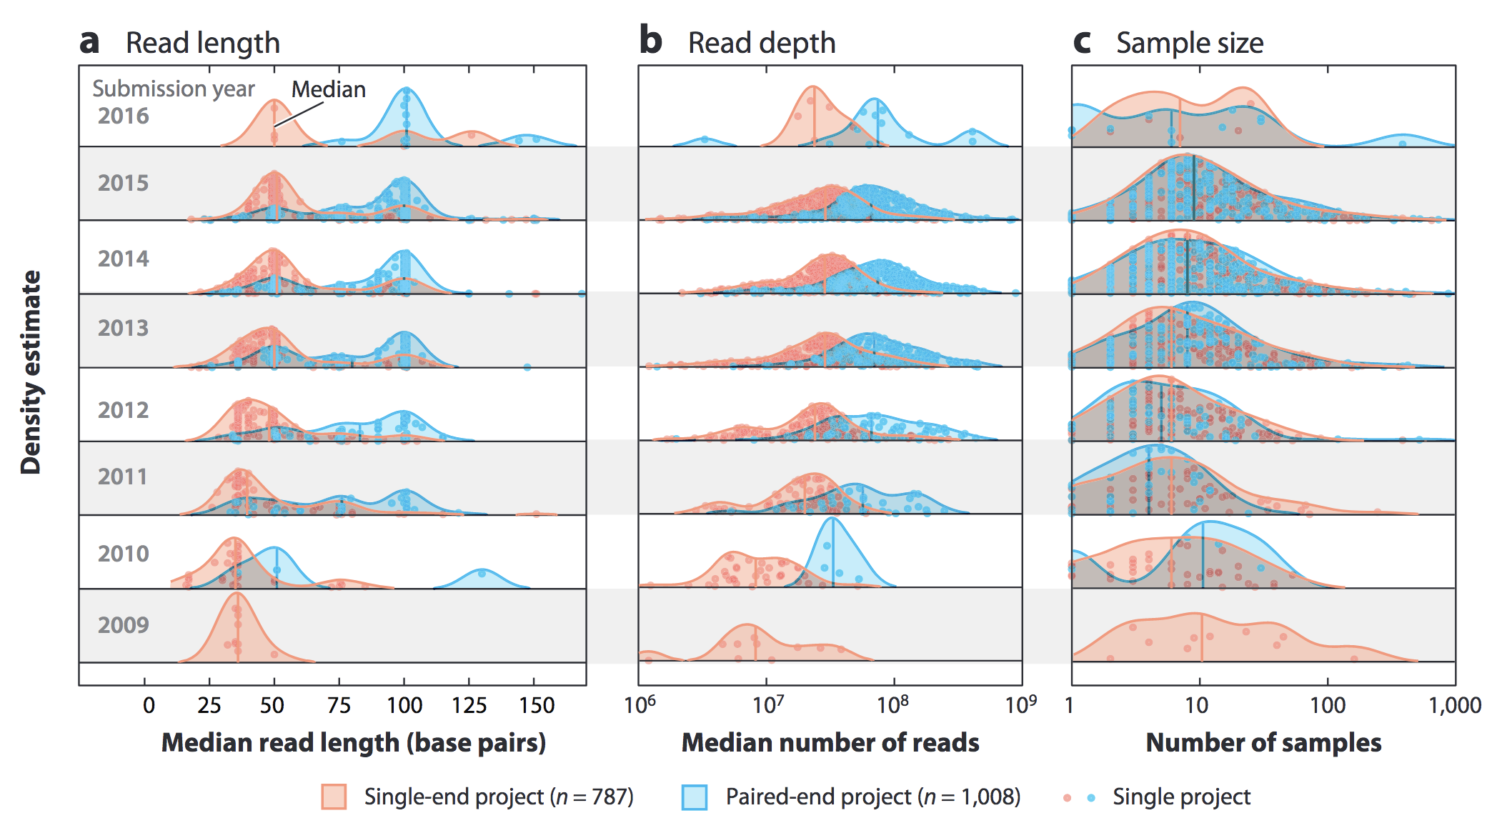
Sequencing (Illumina)
Illumina: Library building: fragment, RT, ligate adapters, PCR
Other types of sequencing: Sanger, other NGS (exome, genome…), targeted sequencing
Van den Berge, Koen et al. “RNA Sequencing Data: Hitchhiker’s Guide to Expression Analysis.” Annual Review of Biomedical Data Science 2 (July): 139–73. https://doi.org/10.1146/annurev-biodatasci-072018-021255.

Slide 7
Sequencing (Illumina)
Single (50 bp) or paired end (100 bp) -> 10-100 millions total reads
250–300 bp for Illumina’s MiSeq
Third-generation technologies: Pacific Biosciences (PacBio), Oxford Nanopore Technologies (ONT) -> allowed for the first complete human genome sequencing
long read and scRNAseq technologies being developed
Single end
Paired end
Longer sequences, more coverage of repetitive sequences and more chances to cover splice junctions

Slide 8
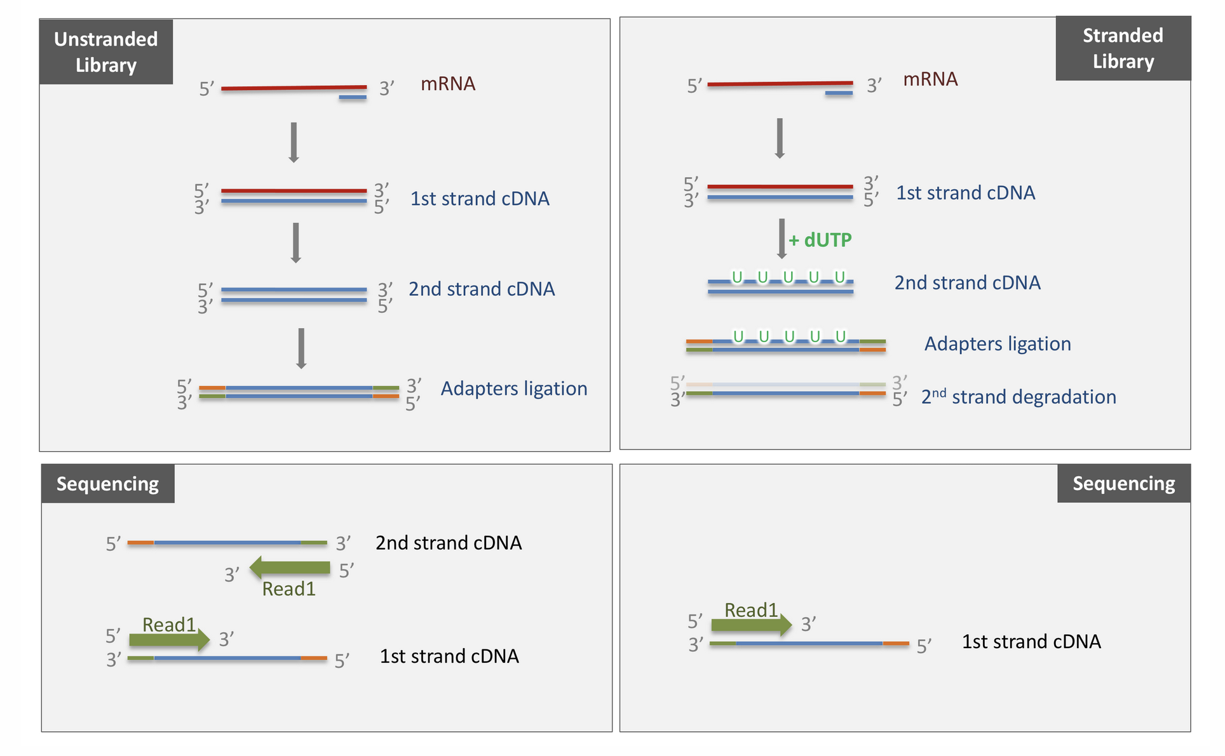
Sequencing (Illumina)
Single (50 bp) or paired end (100 bp) -> 10-100 millions total reads
250–300 bp for Illumina’s MiSeq
Third-generation technologies: Pacific Biosciences (PacBio), Oxford Nanopore Technologies (ONT) -> allowed for the first complete human genome sequencing
long read and scRNAseq technologies being developed
Unstranded and stranded
AAAAAAA
5’
Gene A
3’
Gene B
AAAAAAA

Slide 9
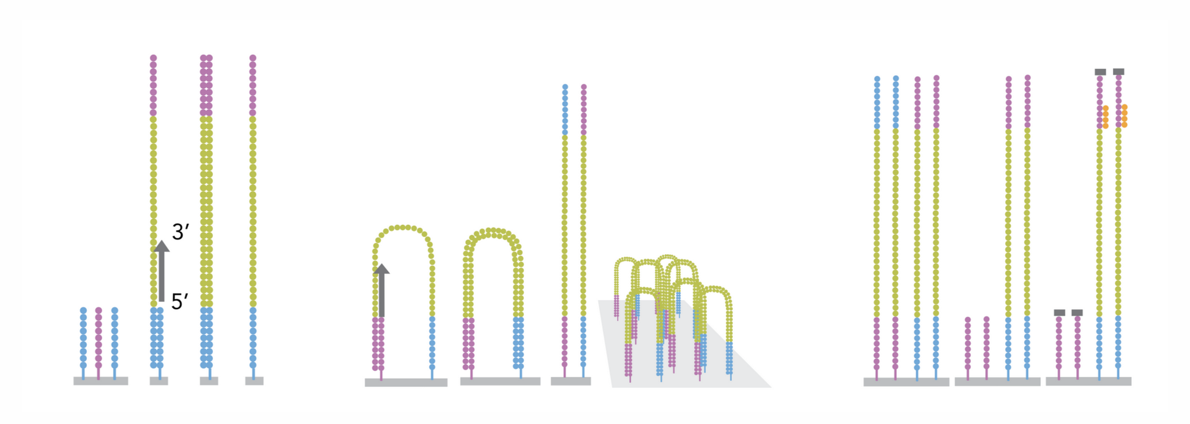
Sequencing (Illumina)
https://www.youtube.com/watch?v=HMyCqWhwB8E

Slide 10
RNA sequencing workflow: Overview
Samples of interest
Total RNA extraction
Data analysis - Differential expression analysis - Variant calling - Novel transcript discovery
Enrichment of target RNA (polyA, rRNA depletion)
cDNA library building (fragment, RT, ligate adapters, amplify)
Sequencing
Mapping (genome or transcriptome)
Experiment design
Experimental part
Outsourced part
Bioinformatics part

Slide 11
Bioinformatic pipeline: FASTQ file processing
Counting
Mapping (genome or transcriptome) Align or pseudoalign
FASTQ files
Quality check and adapter removal
Data analysis - Differential expression analysis - Variant calling - Novel transcript discovery
Outsourced to Raphaël Helaers

Slide 12
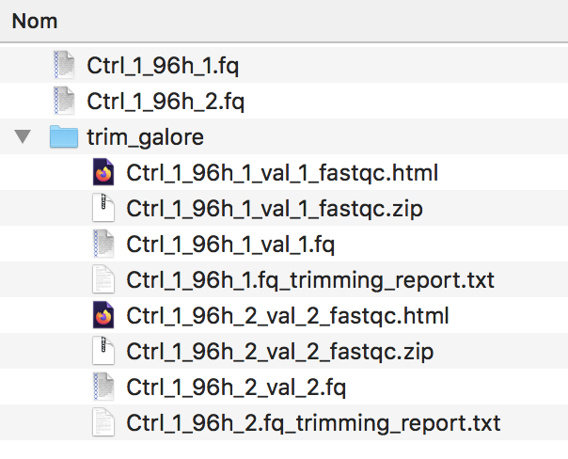
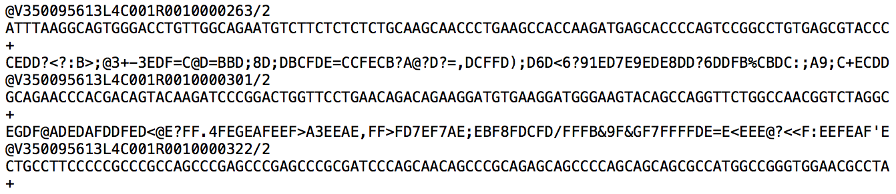
FASTQ files
Each entry in a fastq file consists of 4 lines:
A sequence identifier (by convention preceded by ‘@’) with information about the sequencing run
The sequence
A delimiter, always starting by the sign ‘+’
The base call quality scores. These are Phred scores, encoded using ASCII characters to represent the numerical quality scores. Each character is assigned a quality score between 0 and 40. Quality scores represent the probability that the corresponding nucleotide call is correct.

Slide 13
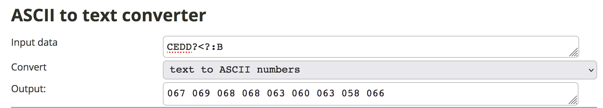
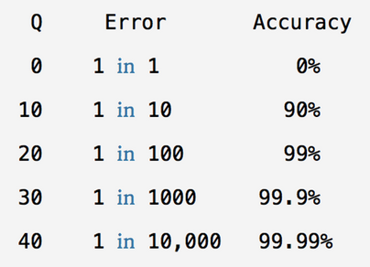
FASTQ files

Slide 14
Bioinformatic pipeline: FASTQ file processing
Counting
Mapping (genome or transcriptome) Align or pseudoalign
FASTQ files
Quality check and adapter removal
Data analysis - Differential expression analysis - Variant calling - Novel transcript discovery
QC using FASTQC
Adapter trimming using Cutadapt or Trimmomatic

Slide 15
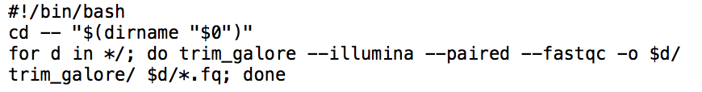
trim_galore
Trim adapters -> FASTQC
Notes:
Trim_galore is a wrapper program that does trimmomatic then FASTQC

Slide 16
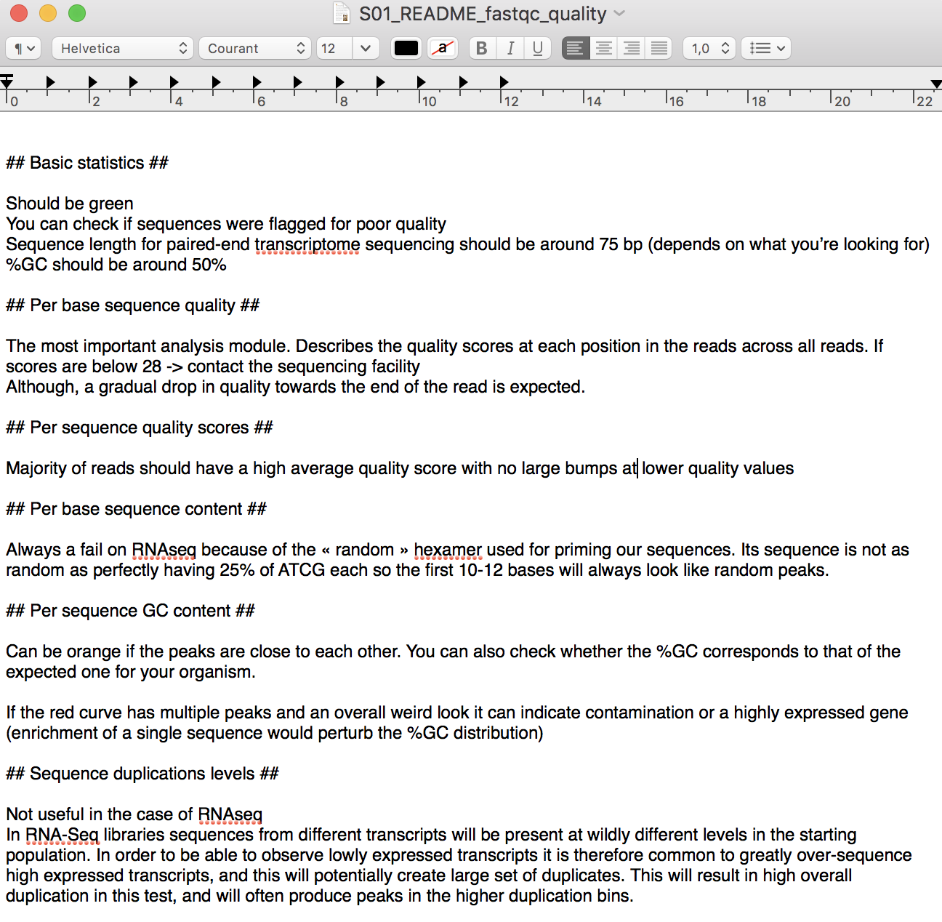
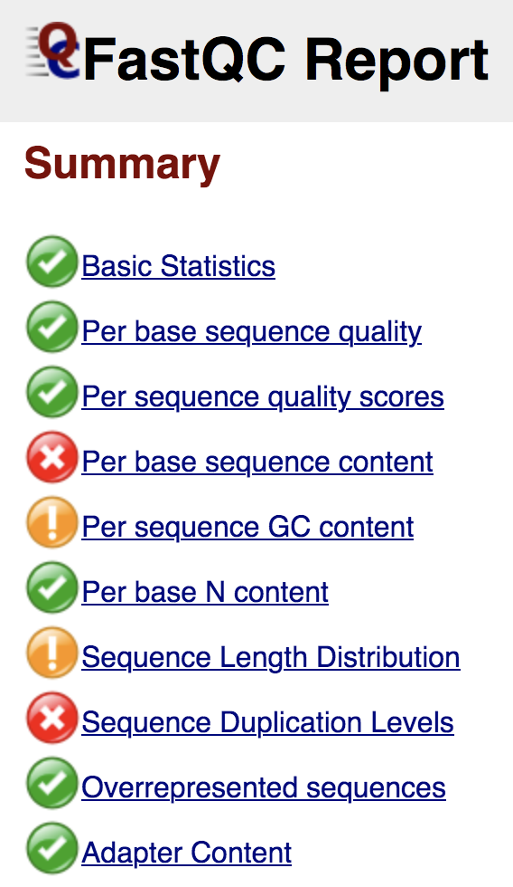
FASTQC report
Notes:
FASTQC generates a report that can be opened and checked

Slide 17

Bioinformatic pipeline: Mapping
Counting
Mapping (genome or transcriptome) Align or pseudoalign
BAM file
FASTQ files
Quality check and adapter removal
Data analysis - Differential expression analysis - Variant calling - Novel transcript discovery

Slide 18
Genome alignment tools
Alignment tools
Build a genomic index -> for “full” alignment (32 gb RAM, 8 threads at least)
Species-dependent
Decide which you use -> GRCh37, GRCh38, GRCh39
“Full” alignment
STAR (>32 gb RAM)
HISAT2
TopHat2
RSubread
…
Pseudoalignment -> no base to base alignment to the genome, better accuracy and speed (20X)
Kallisto (<4gb RAM)
Salmon
Sailfish
-> No information on splicing variants or alignment, only abundance
Runs on Linux, used by Laurent Gatto
Runs on Mac -> well documented for use in R
Runs on Linux -> docker needed on Mac
Python skills needed, used by Stefan

Slide 19
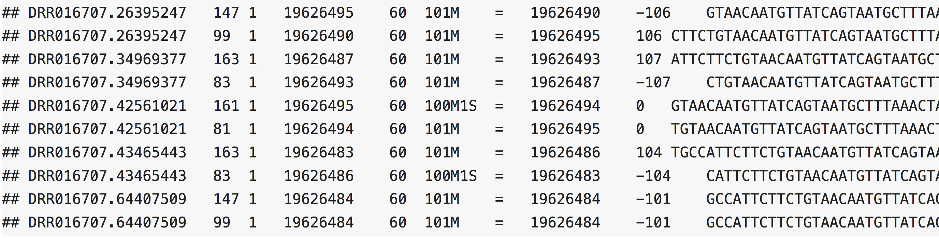
Genome alignment tools
All alignment tools produce BAM files which are binary-compressed SAM files
SAM files are made to store voluminous sequence data and the accompanying information
11 columns for each sequence (at least): ID, SAM Flag, chr of alignement, position of alignment, mapping quality score, CIGAR string, reference name of the mate, position of mate, inferred fragment length, read sequence, Phred score, Optional.
SAM Flag: Are there multiple fragments? Are all fragments properly aligned? Is this fragment unmapped?
Is the next fragment unmapped? Is this query the reverse strand? Is the next fragment the reverse strand? Is this the 1st fragment? Is this the last fragment? Is this a secondary alignment?
Did this read fail quality controls? Is this read a PCR or optical duplicate?

Slide 20
Genome alignment tools
All alignment tools produce BAM files which are binary-compressed SAM files
SAM files are made to store voluminous sequence data and the accompanying information
11 columns for each sequence (at least): ID, SAM Flag, chr of alignement, position of alignment, mapping quality score, CIGAR string, reference name of the mate, position of mate, inferred fragment length, read sequence, Phred score, Optional.
CIGAR string: They are used to indicate things like which bases align (either a match/mismatch) with the reference, are deleted from the reference, and are insertions that are not in the reference.

Slide 21
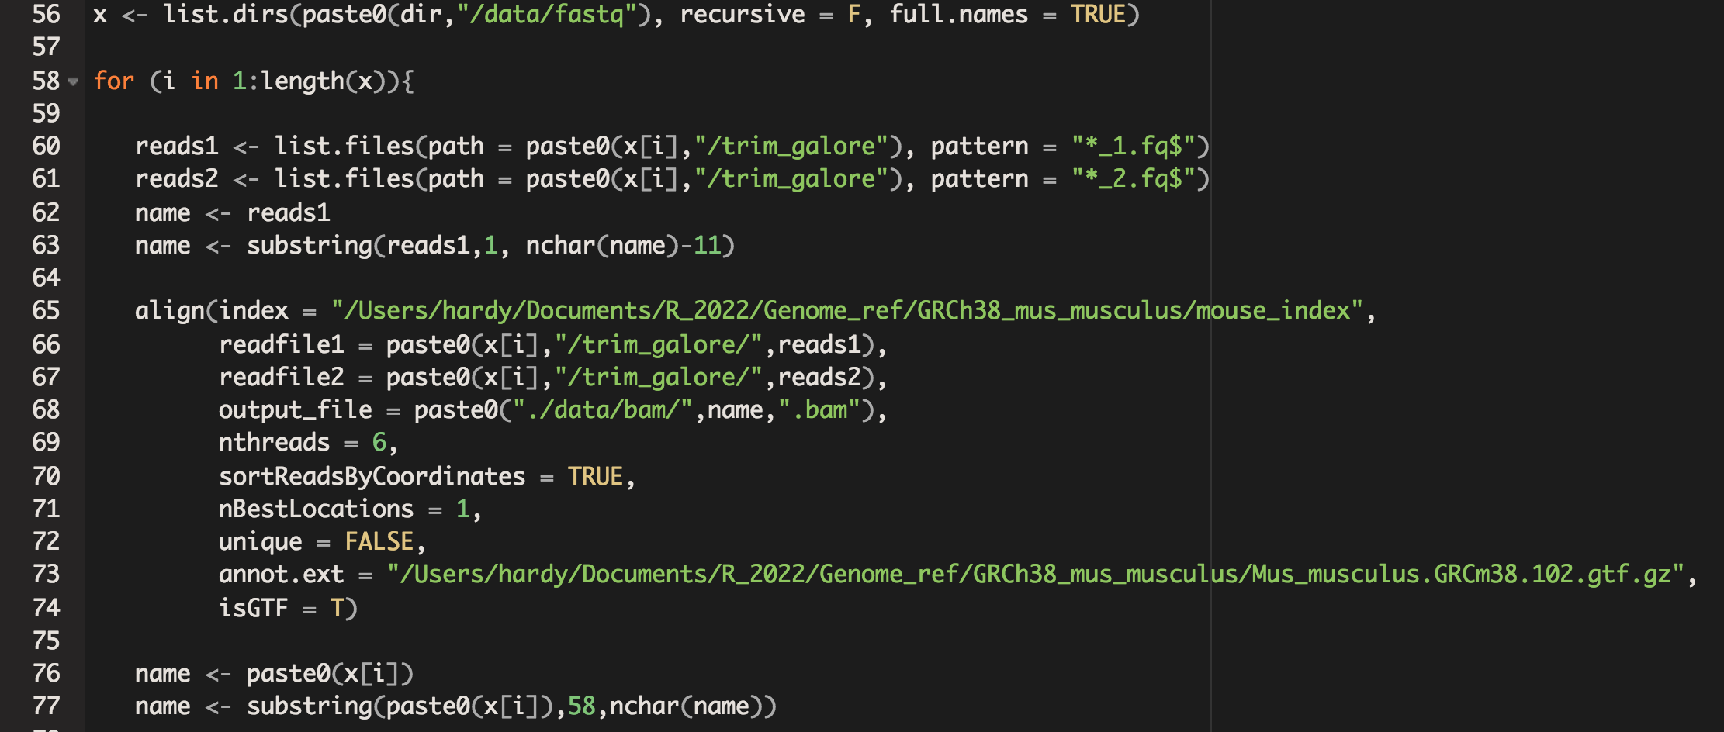
RSubread package: Marion’s script

Slide 22
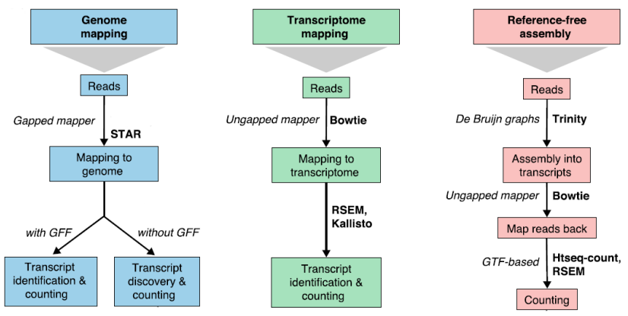
STAR: Spliced Transcripts alignment to a Reference

Slide 23
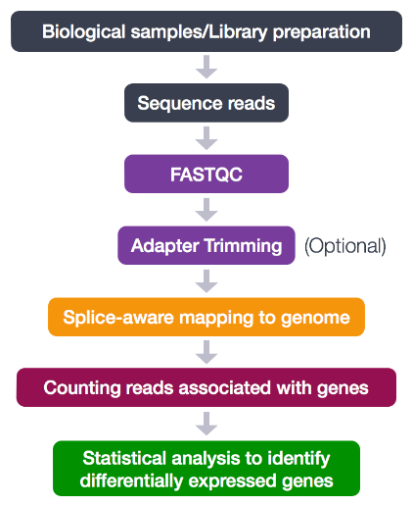
STAR: Spliced Transcripts alignment to a Reference
Linux computer (PC10):
QC using FASTQC
Install STAR, add it to your system path
Download the GRCh38 genome (fasta)
Download the annotations (gtf)
Build the genome index on your computer
Get all you FASTQ files in a folder and decide on a naming convention for reads 1 and reads 2
Align using the STAR count function

Slide 24
Quantifying reads
Counting
Mapping (genome or transcriptome) Align or pseudoalign
BAM files
FASTQ files
Quality check and adapter removal
Data analysis - Differential expression analysis - Variant calling - Novel transcript discovery
featureCounts()

Slide 25
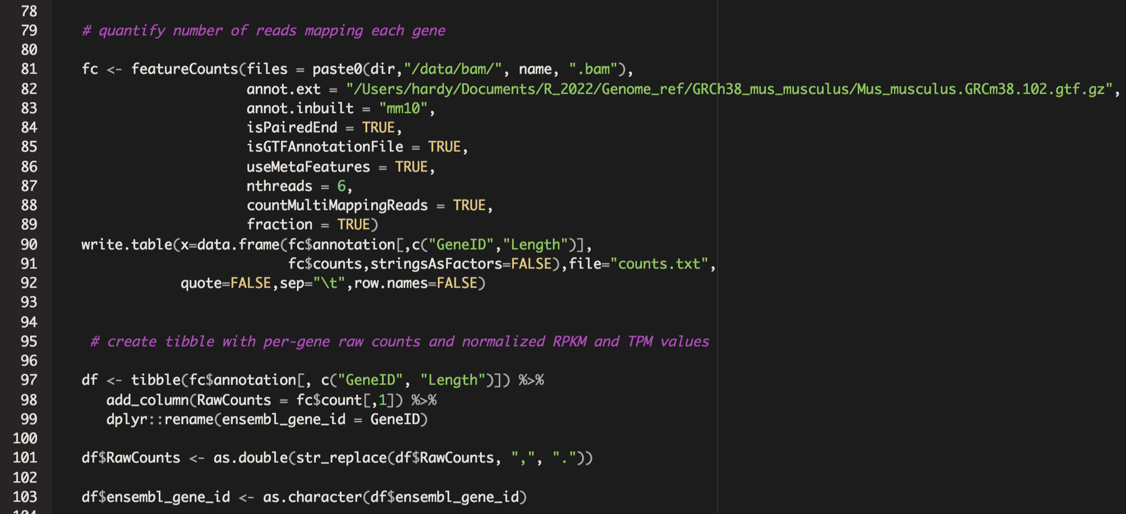
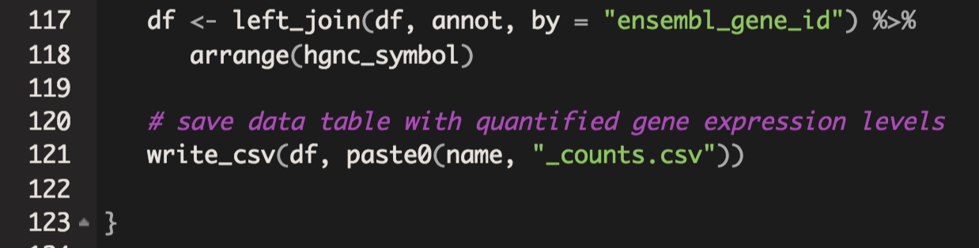
featureCounts() : Quantifying reads
Took 17h for 8 samples

Slide 26
Quantifying reads
Counting
.csv or .tsv
Mapping (genome or transcriptome) Align or pseudoalign
BAM files
FASTQ files
Quality check and adapter removal
Data analysis - Differential expression analysis - Variant calling - Novel transcript discovery

Slide 27
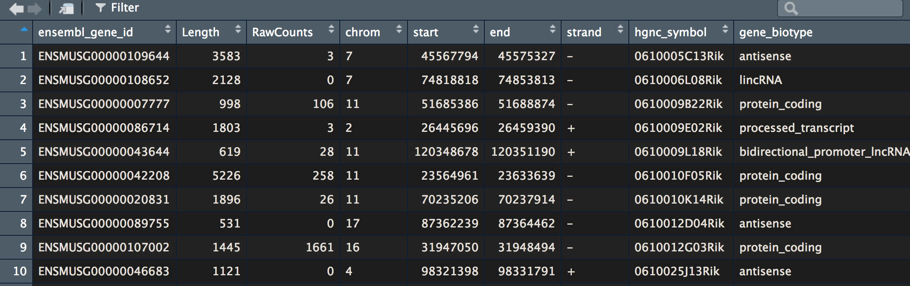
Script output: .csv dataframe with counts

Slide 28
RNA-seq pipeline analysis using R
ch07_RNAseq_pt2 : Analyzing RNAseq data
221102

Slide 29
Data analysis
Counting
.csv or .tsv
Data analysis What is the question you’re asking?

Slide 30
Data analysis: What are the questions you are asking?
How can RNAseq be exploited?
Gene fusion discovery (ChimeraScan, FusionSeq,…)
Small RNAs and lncRNAs (miRDeep, ShirtStack, miRTools…)
Alternative splicing analysis (CuffDiff2, rSeqDiff, DEXSeq, DSGSeq, Diffsplice…)
Differential expression (DESeq2, limma, EdgeR, baySeq, …)

Slide 31
Data analysis: Differential expression
Data analysis Differential expression

Slide 32
Statistics: back to the basics
Statistics: no one agrees on a definition but…
Descriptive
Describe the observed population and the relationship between the different variables it depends on.
Inferential
Predict the behavior of a sample based on the behavior of the population -> “guessing”

Slide 33
Statistics: Variables
Measure levels:
Nominals: Male, Female, …
Ordinals: Cold, tempered, hot, …
Numericals: Temperatures, weight, height, counts …
Types:
Dependent: Uncontrollable, parameter whose variability is caused by the variability of one or multiple other independent variables.
Ex: Blood pressure, speed, tumor growth…
-> The scientist does not control those variables
Independent: Parameter whose variability influences the value of other parameters
Ex: Type of treatment received, concentration of treatment…
-> The scientist controls those variables
Quantitative: Discrete (finite values) or continuous (infinite possible values)
Qualitative: Categorial data -> non numerical

Slide 34
Statistics: Variables
Relationship between variables:
Two dependent variables: Correlation
Simple linear correlation: 2 continuous DVs and normal distribution
Ex: Lifespan vs Tumor size
Association: 2 qualitative DVs
Ex: Survival vs Treatment type
One dependent variable + One independent variable : Regression
Simple linear regression: 1 quant cont DV, 1 quant cont IV and normal distributions
Ex: Lifespan vs Treatment concentration
Logistical regression: 1 quantitative continuous IV and 1 qualitative DV
Ex: Lifespan vs Treatment type
Multiple regression: 1 DV and multiple IVs
Canonical correlation: multiple DVs and IVs, quantitative, continuous and normal distributions

Slide 35
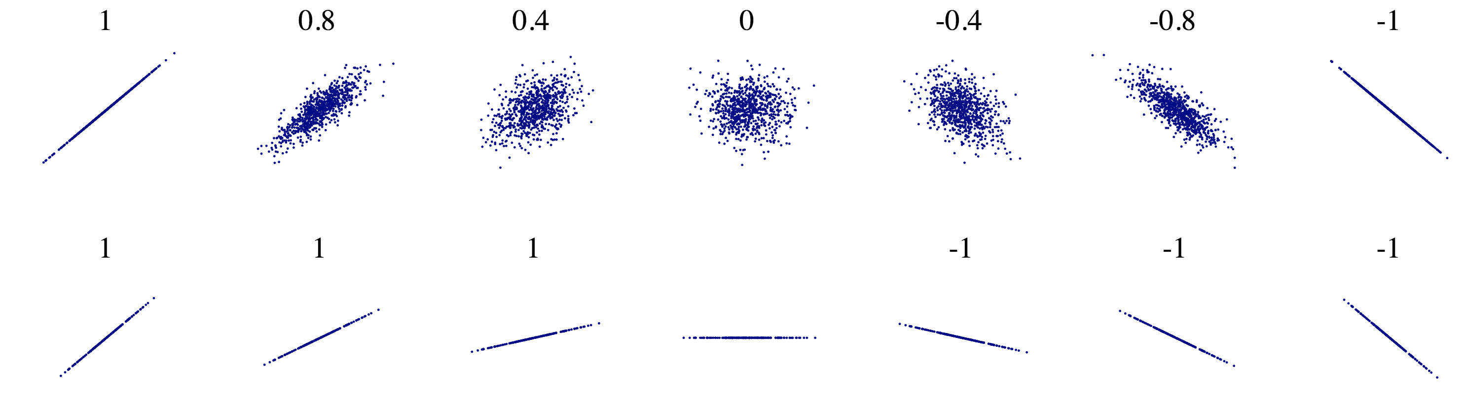
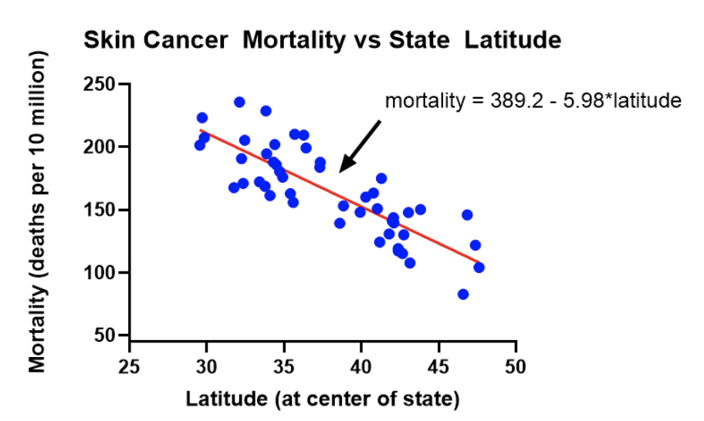
Statistics: Variables
Relationship between variables:
Two dependent variables: Correlation -> The two variables move together (can interchange X and Y)
One dep variable + One indep variable : Regression –> Cause and effect (cannot interchange X and Y)
R score
Mortality = a + b*Latitude
R² however, represents the proportion of variation in Y explained by X, here R = -0.82*, R² = 0.67
Regression can be used for prediction!
Notes:
*The X variable can be fixed with correlation, but confidence intervals and statistical tests are no longer appropriate. Typically, regression is used when X is fixed.

Slide 36
Which statistical test to use for differential expression ?
Data type
Qualitative (categorical)
Type of categorization
Quantitative (measurements)
Type of question
One categorical variable
Two categorical variables
χ² adjusting test
χ² contigency table
Relationship
Differences
Number of predictors
One
Multiple
Measurement
Continuous
Ranks: Spearman’s rank correlation
Degree of relationship: Pearson correlation
Type of relationship: Regression
Multiple regression
Number of groups
Two
Multiple
Dependent samples (paired)
Parametric: t student
Non parametric: Mann-Whitney
T paired
Wilcoxon
Independent samples (not paired)
Dependent samples (paired)
One independent variable
Multiple independent variables
Factorial ANOVA
Parametric: Repeated measurements
Non parametric: Friedman
Independent samples (not paired)
Parametric: one-way ANOVA
Non parametric: Kruskal-Wallis

Slide 37
Differential expression analysis: t student
-> Tests if the difference between mean counts of a given gene in the sample A and B have the same amplitude as non-explainable random variations.
-> Another way to ask the question: Is the difference in the mean abundance of a given gene truy different between A and B or is it just due to randomness.
Conditions:
Samples A and B are independent
We are comparing two groups
Distribution of residues must be normal
No atypical data (outliers)
Null hypothesis: H0: The average abundances of a given gene between A and B are equal
μ_{A}-μ_{B}= 0 ou μ_{A}=μ_{B}
Our hypothesis: H1: The average abundances of a given gene between A and B are not equal
μ_{A}≠μ_{B}
Alpha = 0.05
Untrue for RNAseq

Slide 38
Differential expression analysis: RNAsequencing
The reason we don't use those tests individually in most cases is because the distributions of abundances don't meet the requirements of our standard tests (normality, homogeneity of variances, etc.) and those tests don’t adjust for multiple testing by default either.
To assist with this, we need to use validated algorithms that generally perform these steps:
In R :
DESeq2
limma
EdgeR
baySeq
EBSeq
DEGSeq
cuffdiff
PoissonSeq
NOISeq
SAMSeq

Slide 39
Differential expression analysis: Which package to choose
Count-based model : Uses dispersion estimates
DESeq
DESeq2
EdgeR
Linear-based model : Uses variance estimates
limma
Non-parametric-based models
NOISeq
SAMSeq

Slide 40
Differential expression analysis: Which package to choose
No statistical modeling can fully capture biological phenomena. Statistical methods all rely on assumptions and requirements that are only partially satisfied.
Different methods rely on different assumptions, and in turn, may capture different projections of the reality.
The different results are not mutually exclusive.
One of them, neither or all may be true - all at the same time!

Slide 41
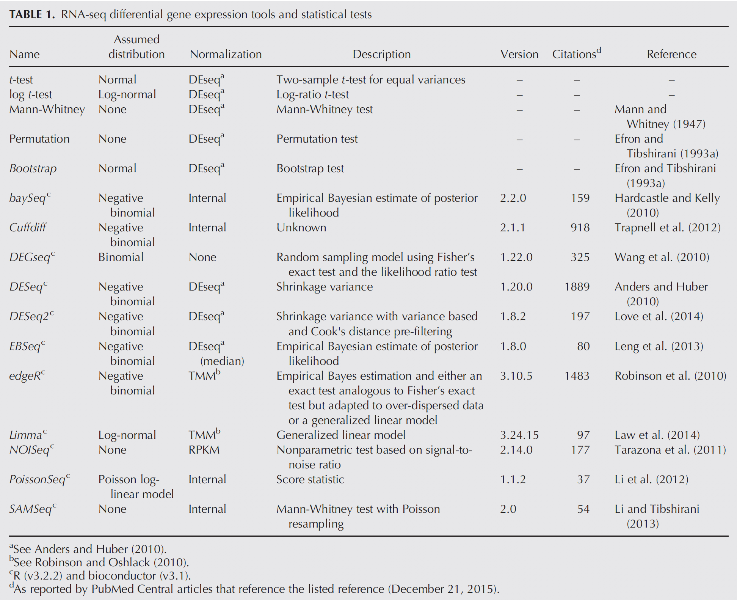
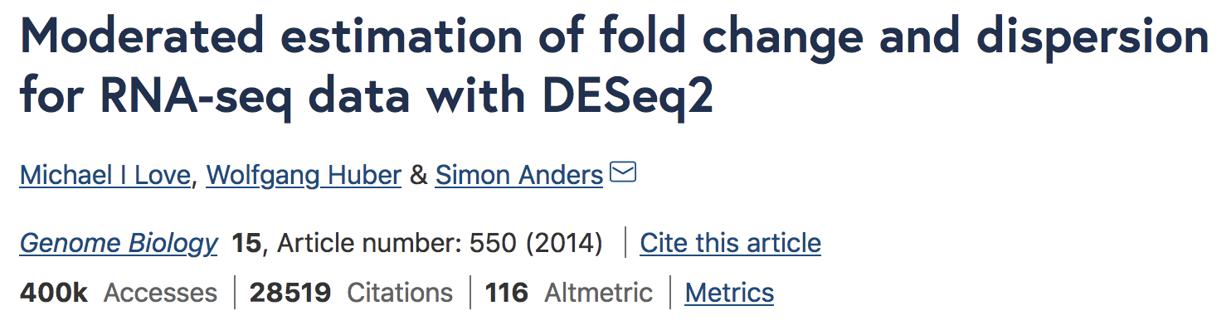
Differential expression analysis: Which package to choose
Number of citations per method used in the literature
Schurch NJ, et al, How many biological replicates are needed in an RNA-seq experiment and which differential expression tool should you use? RNA. 2016 Jun;22(6):839-51. doi: 10.1261/rna.053959.115.

Slide 42
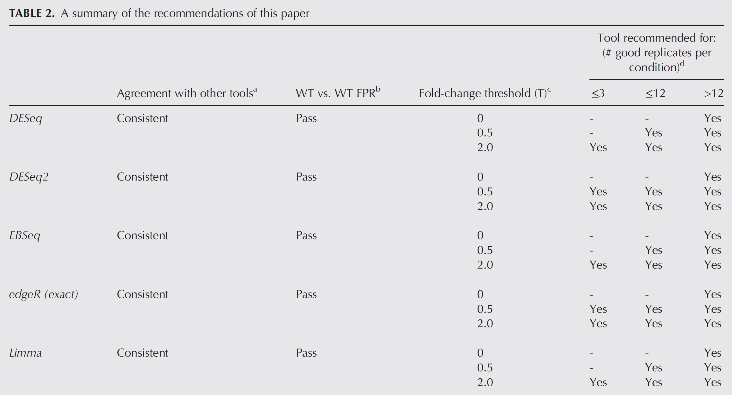
Differential expression analysis: Which package to choose
For 3 replicates : 9 out of 11 tools found only 20%–40% of the significantly differentially expressed (SDE) genes identified with the full set of 42 clean replicates. This rises to >85% for the subset of SDE genes changing in expression by more than log2Fc = 2.
To achieve >85% for all SDE genes regardless of fold change requires more than 20 biological replicates
Notes:
Schurch NJ, et al, How many biological replicates are needed in an RNA-seq experiment and which differential expression tool should you use? RNA. 2016 Jun;22(6):839-51. doi: 10.1261/rna.053959.115.

Slide 43
Data analysis: Differential expression workflow with DESeq2
Data analysis Differential expression
DESeq2
Prepare the count matrix and the colData()
Open your R script called ch07_DESeq2
Install DESeq2 using biocmanager

Slide 44
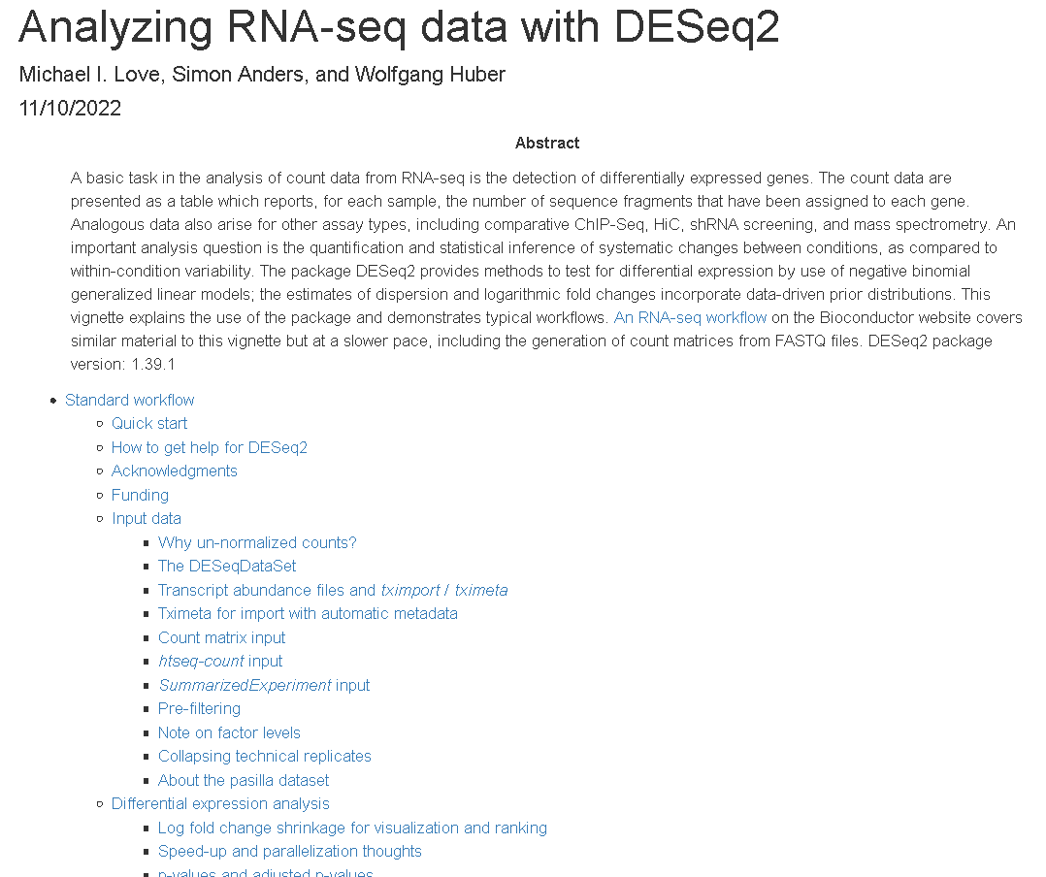
DESeq2: Vignette
http://bioconductor.org/packages/devel/bioc/vignettes/DESeq2/inst/doc/DESeq2.htm

Slide 45
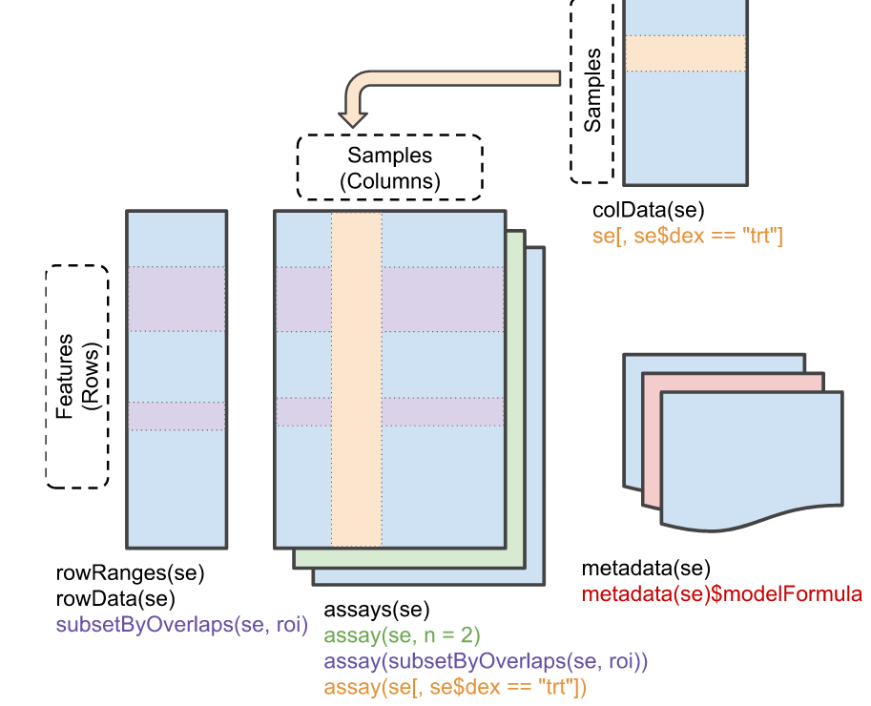
DESeq2: DESeq object creation
coldata : information on your samples
 | Celltype | Timeline | Replicate
C48_1 | Ctrl | 48 | 1
C48_2 | Ctrl | 48 | 2
C96_1 | Ctrl | 96 | 1
C96_2 | Ctrl | 96 | 2
S48_1 | Selected | 48 | 1
S48_2 | Selected | 48 | 2
S96_1 | Selected | 96 | 1
S96_2 | Selected | 96 | 2
 | C48_1 | C48_2 | S48_1 | S48_2 | C96_1 | C96_2 | S96_1 | S96_2
ENSG00000001 | 23 | 12 | 0 | 0 | 56 | 56 | 2 | 8
ENSG0000002 | 12 | 15 | 15 | 18 | 0 | 2 | 1 | 10
ENSG00000003 | 12 | 15 | 14 | 36 | 44 | 56 | 89 | 120
Count matrix: counts in each sample per gene

Slide 46
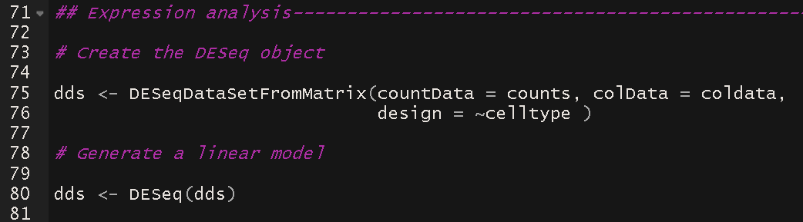
Data analysis: Differential expression workflow with DESeq2
Data analysis Differential expression
DESeq2
Prepare the count matrix and the colData() and create the dds object

Slide 47
Data analysis: Differential expression workflow with DESeq2
Data analysis Differential expression
DESeq2
Size factor estimation
Dispersion estimation
Generalized linear model fit
Statistical test
Prepare the count matrix and the colData() and create the dds object

Slide 48
DESeq2: Size factor estimation
Takes into account
Sequencing depth
Library composition
Then, normalizes the counts using the median of ratios method
Sample 1
Sample 2
Gene A
Gene A
Gene B
Gene B

Slide 49
DESeq2: Size factor estimation
Takes into account
Sequencing depth
Library composition : a few highly differentially expressed genes, differences in the number of genes expressed between samples, or presence of contaminations can skew library composition
Then, normalizes the counts using the median of ratios method
Sample 1
Sample 2
10 counts
10 counts
Gene A
Gene A
32 counts
0 counts
Gene B
Gene B
Notes:
Sample 1: Gene A : 10/10 = 1
Sample 1: Gene B : 0/10 = 0
Sample 2: Gene A : 10/42 = 0.24 -> 86% decrease in expression
Sample 2: Gene B: 32/42 = 0.76

Slide 50
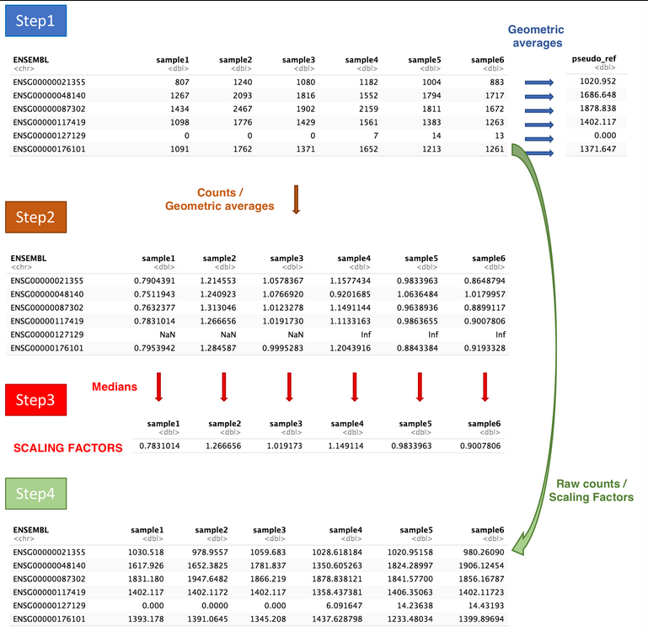
DESeq2: Size factors estimation
Illustration from Laurent Gatto’s course:
https://uclouvain-cbio.github.io/WSBIM2122/sec-rnaseq.html
Notes:
Sample 1: Gene A : 10/10 = 1
Sample 1: Gene B : 0/10 = 0
Sample 2: Gene A : 10/42 = 0.24 -> 86% decrease in expression
Sample 2: Gene B: 32/42 = 0.76

Slide 51
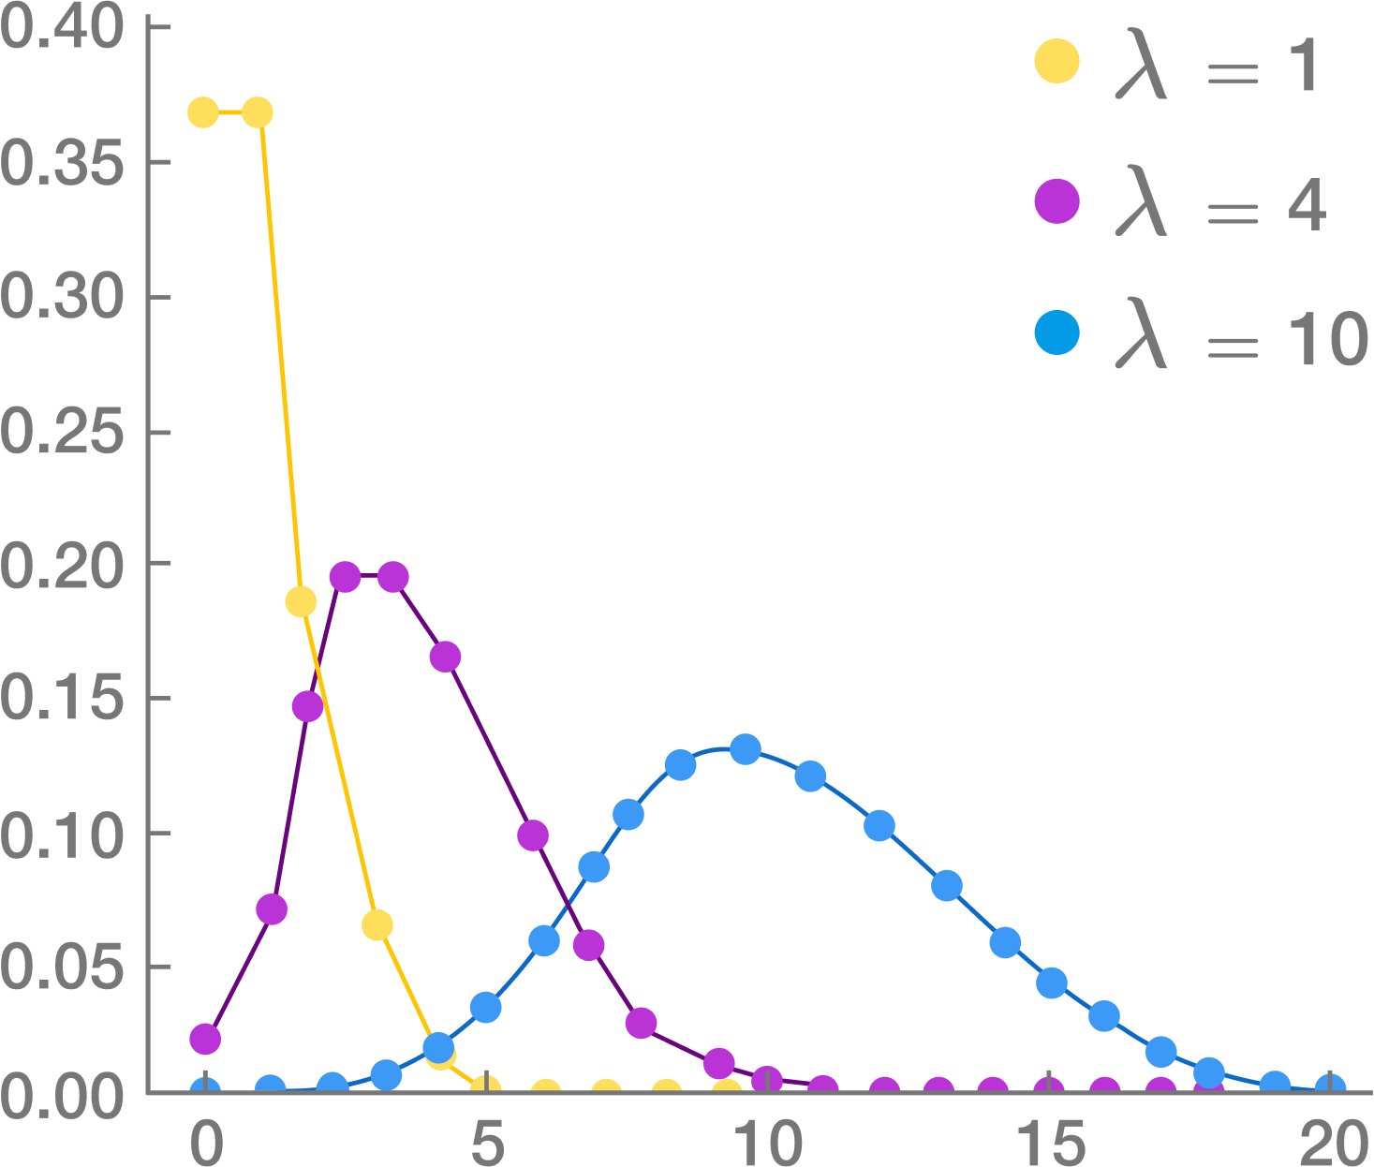
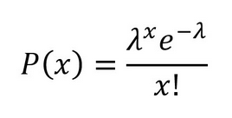
DESeq2: Model fitting
RNA sequencing often follows a Poisson distribution but can only be true when comparing technical replicates in a same sample as it only reflects the counting noise in the variance. In biological replicates, the variance can originate from more than the counting noise.
So in RNAseq, DESeq2 uses the Poisson-derived negative binomial distribution. It has an extra parameter: « dispersion » which models this extra variance we empirically see in RNAseq between biological replicates.
Dispersion estimation

Slide 52
Data analysis: Differential expression workflow with DESeq2
Data analysis Differential expression
DESeq2
Size factor estimation
Dispersion estimation
Generalized linear model fit
Statistical test
Prepare the count matrix and the colData()
Quality check

Slide 53
Data analysis: Differential expression workflow with DESeq2
Data analysis Differential expression
DESeq2
Size factor estimation
Dispersion estimation
Generalized linear model fit
Statistical test
Prepare the count matrix and the colData()
Quality check
PCA
sizeFactors
plotDispEsts

Slide 54
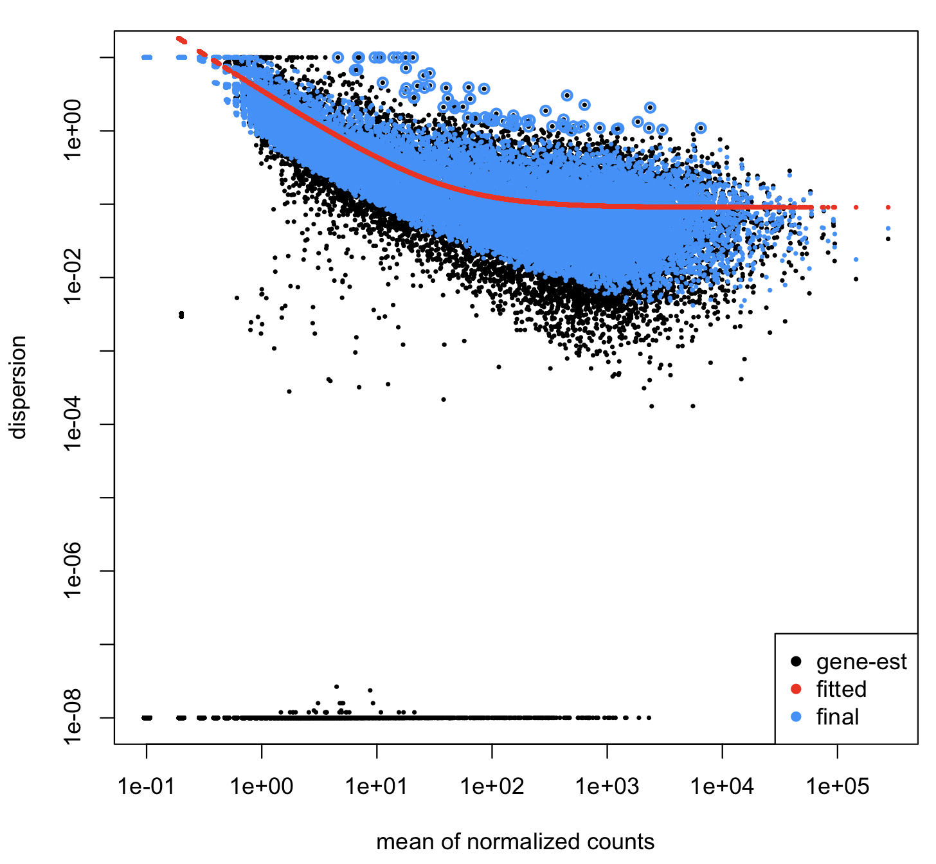
DESeq2: Size factors and dispersion estimates
Notes:
To perform differential expression call DESeq will assume that, for each gene, the read counts are generated by a negative binomial distribution. One problem here will be to estimate, for each gene, the two parameters of the negative binomial distribution: mean and dispersion.
The mean will be estimated from the observed normalized counts in both conditions.
The first step will be to compute a gene-wise dispersion. When the number of available samples is insufficient to obtain a reliable estimator of the variance for each gene, DESeq will apply a shrinkage strategy, which assumes that counts produced by genes with similar expression level (counts) have similar variance (note that this is a strong assumption). DESeq will regress the gene-wise dispersion onto the means of the normalized counts to obtain an estimate of the dispersion that will be subsequently used to build the binomial model for each gene.
Source: https://dputhier.github.io/ASG/practicals/rnaseq_diff_Snf2/rnaseq_diff_Snf2.html
Low dispersion genes: These genes with very low variability between samples so possibly housekeeping genes. They are genes where there was not sufficient information to estimate the dispersion, so the experiment-wide prior helps a lot with estimation.

Slide 55
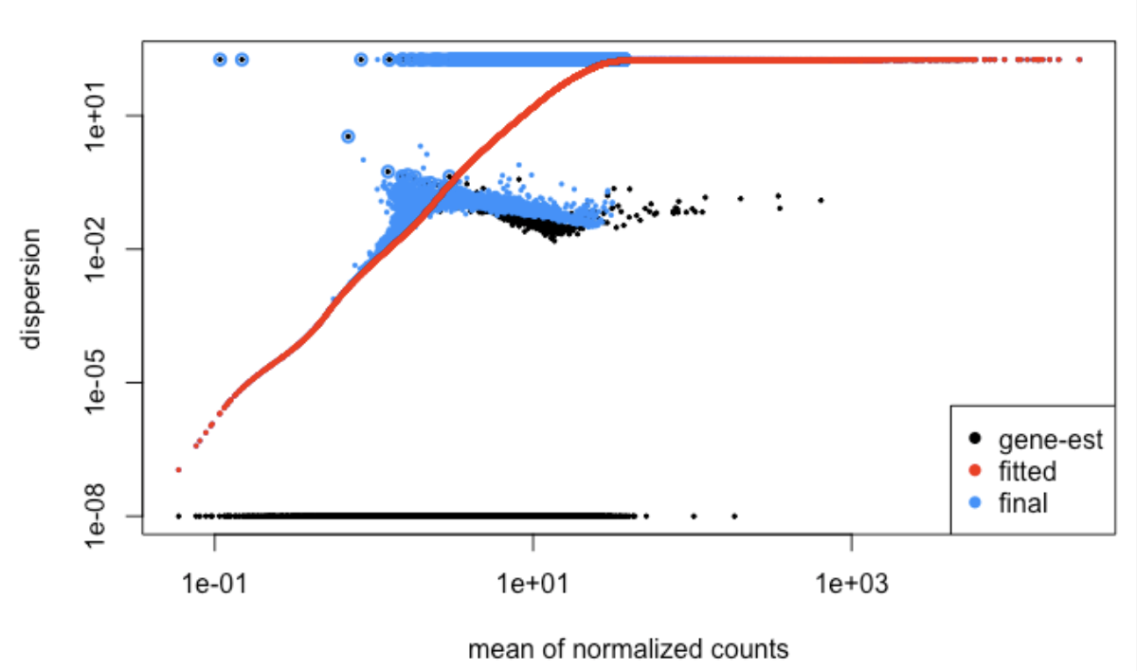
DESeq2: Size factors and dispersion estimates
From Frederik Ziebell at https://support.bioconductor.org/p/107937/
Notes:
The problem was a batch effect and a poor experimental design where some runs overlapped with some conditions and others with multiple conditions

Slide 56
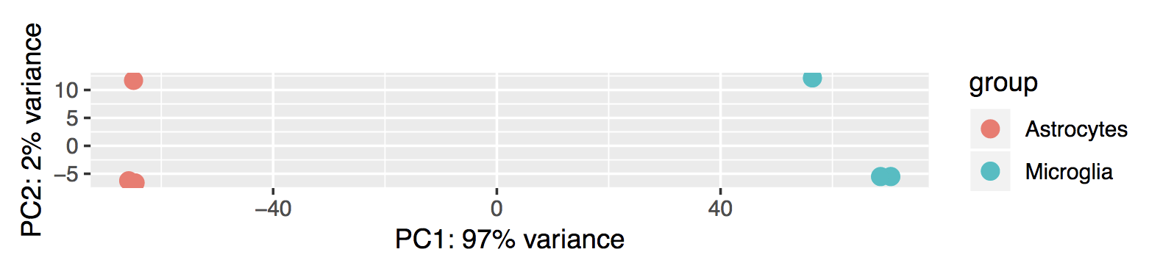
DESeq2: PCA

Slide 57
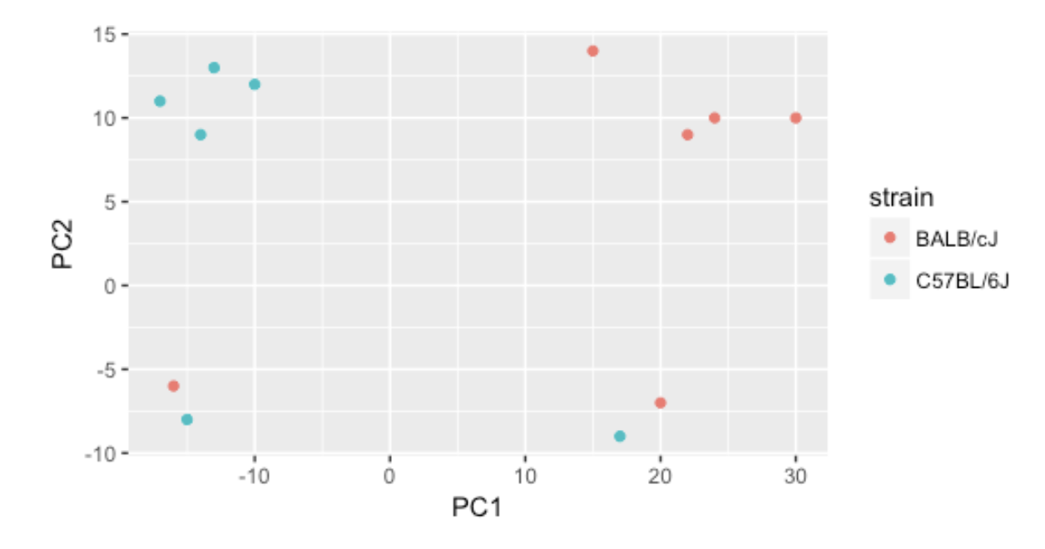
DESeq2: PCA

Slide 58
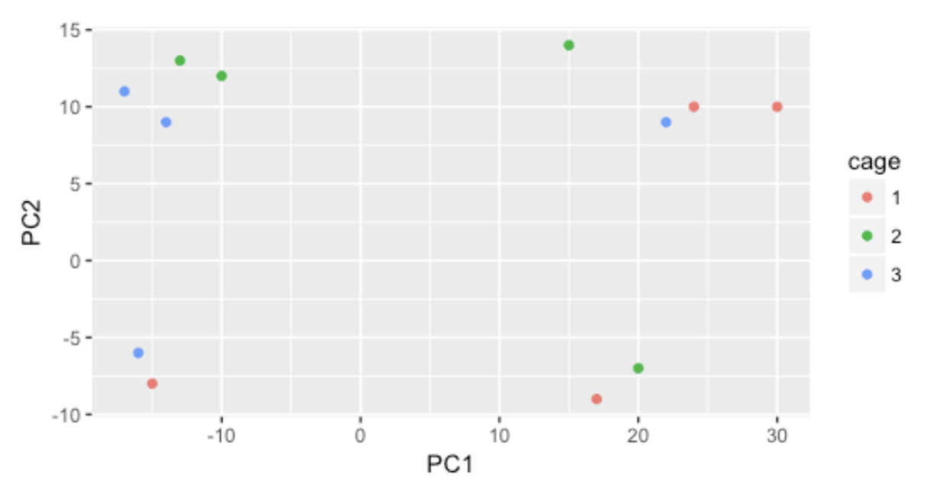
DESeq2: PCA

Slide 59
DESeq2: PCA

Slide 60
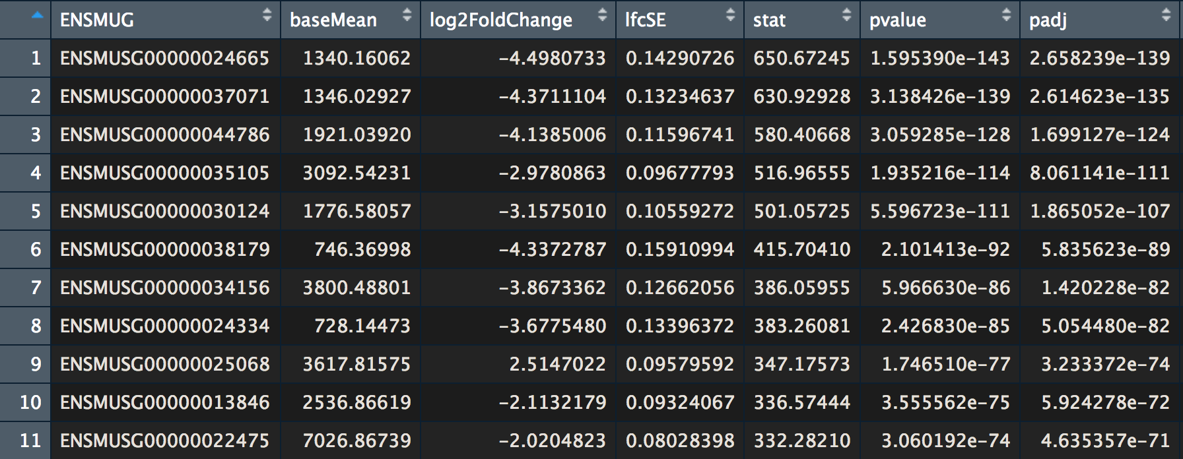
DESeq2: Results

Slide 61
DESeq2: Results
Test statistic
L2Fc standard deviation
Count means
Adjusted pvalue
Ensembl ID

Slide 62
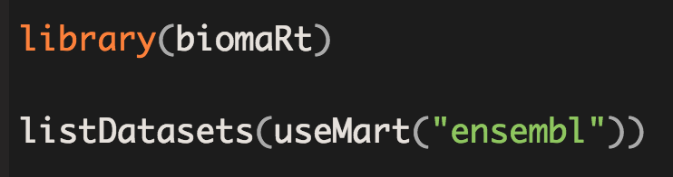
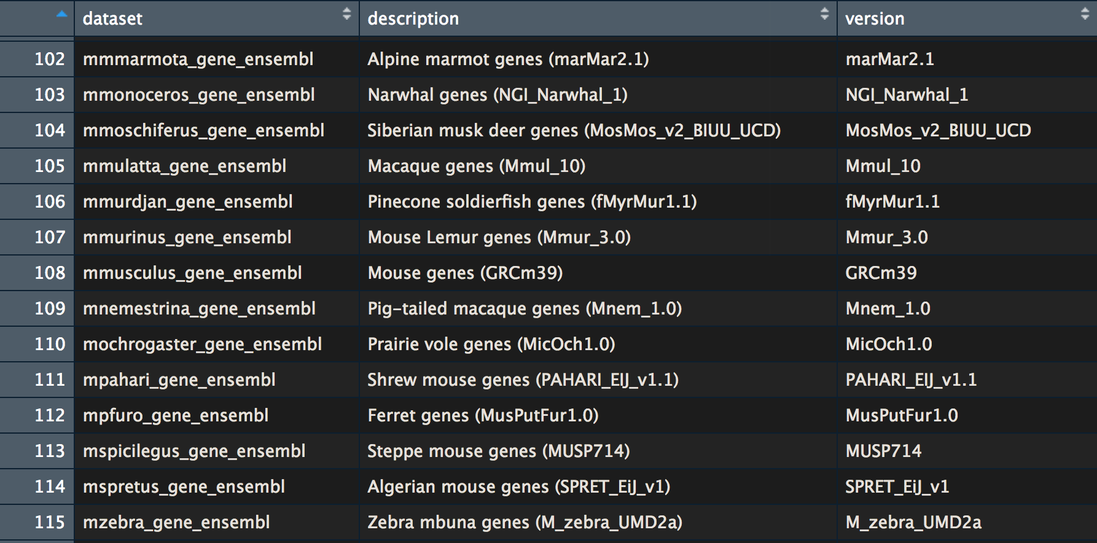
Annotating genes: biomaRt
Tool to export datasets from Ensembl.org
215 datasets
Mus musculus
(based on C57BL/6)

Slide 63
biomaRt attributes
Feature page: Ensembl gene ID, description, gene % GC content, phenotype description, …
Homologs: Same thing but from another organism + last common ancestor
SNP: Variant name, clinical significance, peptide location, …
Structure / sequences: exons, cDNA, coding sequence, 3’UTR, 5’UTR, …

Slide 64
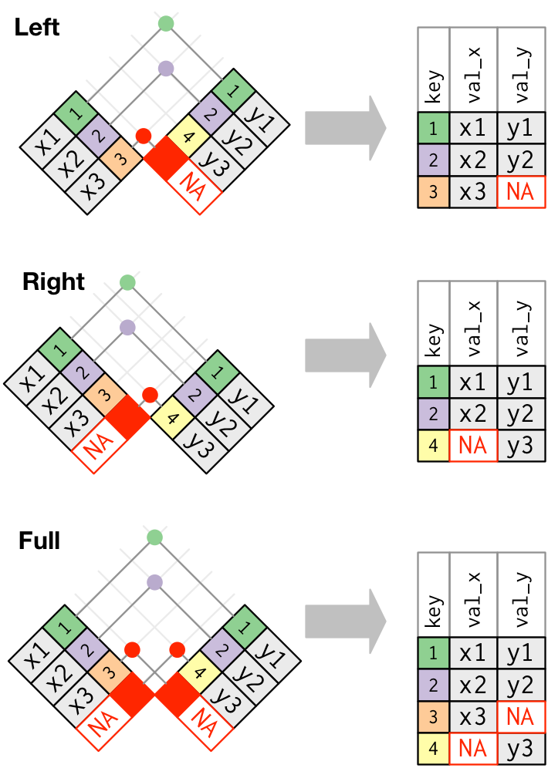
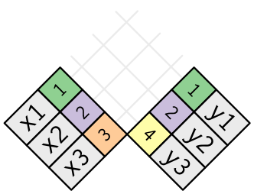
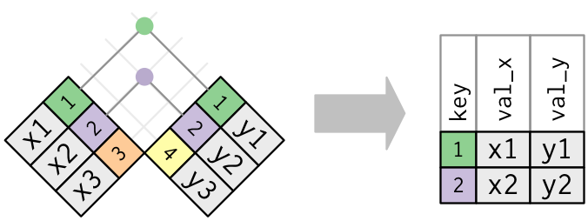
Tidyverse: joining tables
Inner
Notes:
R for data sciences https://r4ds.had.co.nz/relational-data.html

Slide 65
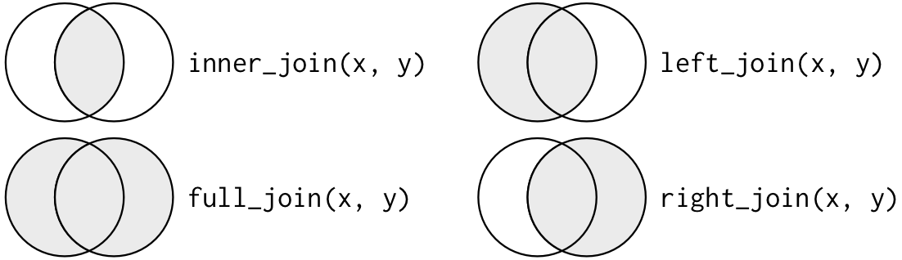
Tidyverse: joining tables
Notes:
R for data sciences https://r4ds.had.co.nz/relational-data.html

Slide 66
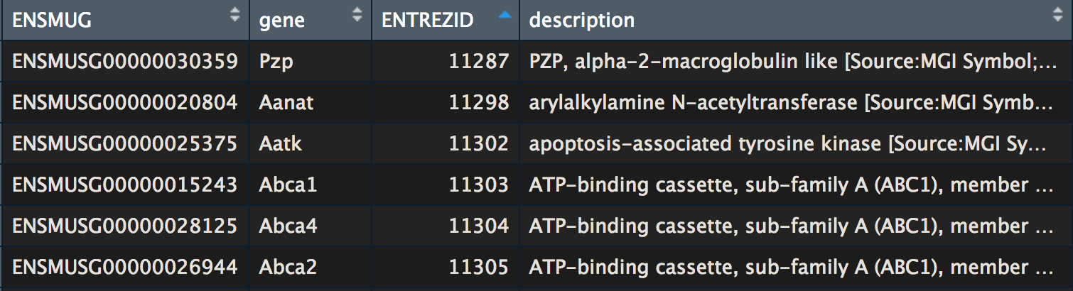
Tidyverse: joining tables
Combine your results with the annotation table
?_join(res_tbl, ensembl_to_gene)

Slide 67
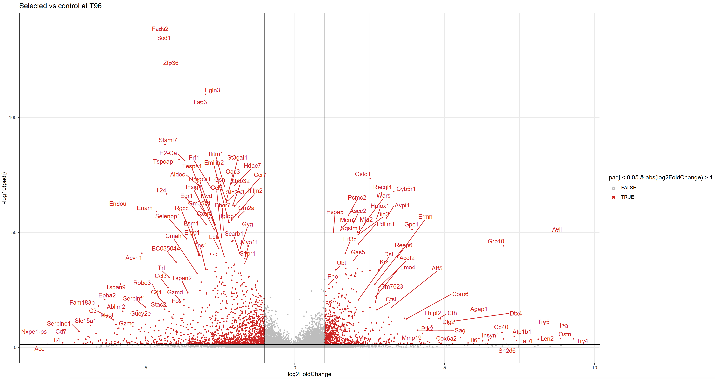
Results visualization: Volcano plot

Slide 68
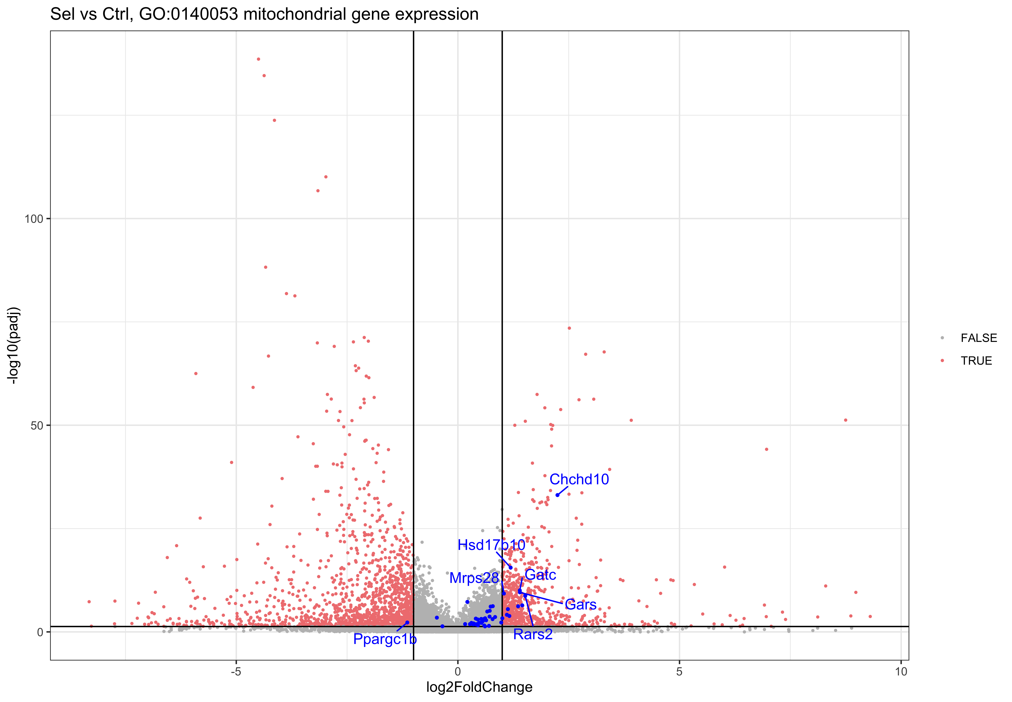
Results visualization: Volcano plot and highlights

Slide 69
Results analysis: Enrichment of specific genes
Over-Representation Analysis (ORA)
Input:
Significant and Lfc <>= 1 genes
Background genes (all detected genes)
Dependent on the statistics you used and the upheld thresholds.
« A pathway with a lot of DE genes is more significantly enriched than a pathway with less DE genes »
Not topology based
Misses the change magnitude
Gene Set Enrichment Analysis (GSEA)
Input:
Ranked genes list
Independent of the gene selection criteria, more sensitive to small but coordinated changes in gene sets of functionally related genes.
« Coordinated small changes in specific pathway-related genes and big changes in those genes indicate an enriched pathway »
Not topology based
Misses the change magnitude
Notes:
https://advaitabio.com/ipathwayguide/pathway-analysis-vs-gene-set-analysis/
GSEA: Subramanian et al. 2005

Slide 70
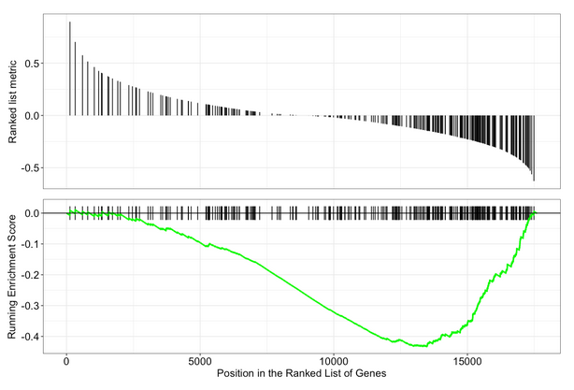
Results analysis: Enrichment of specific genes
Over-Representation Analysis (ORA)
Input:
Significant and Lfc <>= 1 genes
Background genes (all detected genes)
Dependent on the statistics you used and the upheld thresholds.
« A pathway with a lot of DE genes is more significantly enriched than a pathway with less DE genes »
Not topology based
Misses the change magnitude
Gene Set Enrichment Analysis (GSEA)
Input:
Ranked genes list
Independent of the gene selection criteria, more sensitive to small but coordinated changes in gene sets of functionally related genes.
« Coordinated small changes in specific pathway-related genes and big changes in those genes indicate an enriched pathway »
Not topology based
Misses the change magnitude
Notes:
https://advaitabio.com/ipathwayguide/pathway-analysis-vs-gene-set-analysis/
GSEA: Subramanian et al. 2005

Slide 71
Enrichment analysis: database query
Gene Ontology (GO)
Biological process: refers to the biological role involving the gene or gene product, and could include “transcription”, “signal transduction”, and “apoptosis”. A biological process generally involves a chemical or physical change of the starting material or input.
Molecular function: represents the biochemical activity of the gene product, such activities could include “ligand”, “GTPase”, and “transporter”.
Cellular component: refers to the location in the cell of the gene product. Cellular components could include “nucleus”, “lysosome”, and “plasma membrane”.
Each GO term has a term name (e.g. DNA repair) and a unique term accession number (GO:0005125), and a single gene product can be associated with many GO terms, since a single gene product “may function in several processes, contain domains that carry out diverse molecular functions, and participate in multiple alternative interactions with other proteins, organelles or locations in the cell”…
Notes:
Pathway-Express [5, 18], SPIA [27], ROntoTools [29], BLMA [22, 23]), as well as others (NetGSA [24], TopoGSA [9], TopologyGSA [20], DEGraph [16], PWEA [15], PathOlogist [11], GGEA [8], cepaORA, cepaGSA [12, 13], PathNet [6], etc.

Slide 72
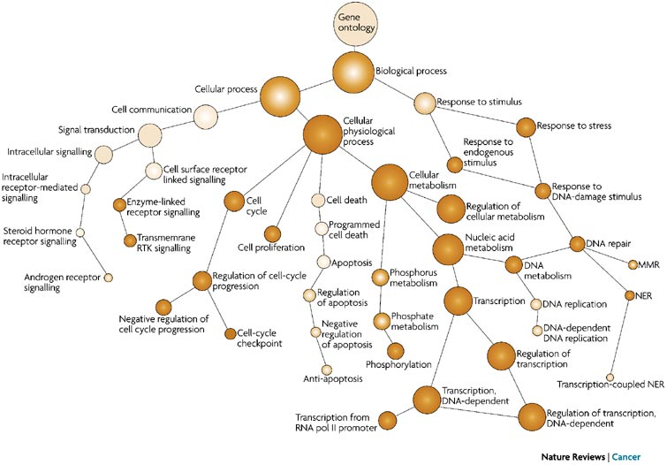
Enrichment analysis: database query
Gene Ontology (GO)

Slide 73
Enrichment analysis: database query
Gene Ontology (GO)
Biological process: refers to the biological role involving the gene or gene product, and could include “transcription”, “signal transduction”, and “apoptosis”. A biological process generally involves a chemical or physical change of the starting material or input.
Molecular function: represents the biochemical activity of the gene product, such activities could include “ligand”, “GTPase”, and “transporter”.
Cellular component: refers to the location in the cell of the gene product. Cellular components could include “nucleus”, “lysosome”, and “plasma membrane”.
Reactome
KEGG
Wikipathways
Biocarta
…

Slide 74
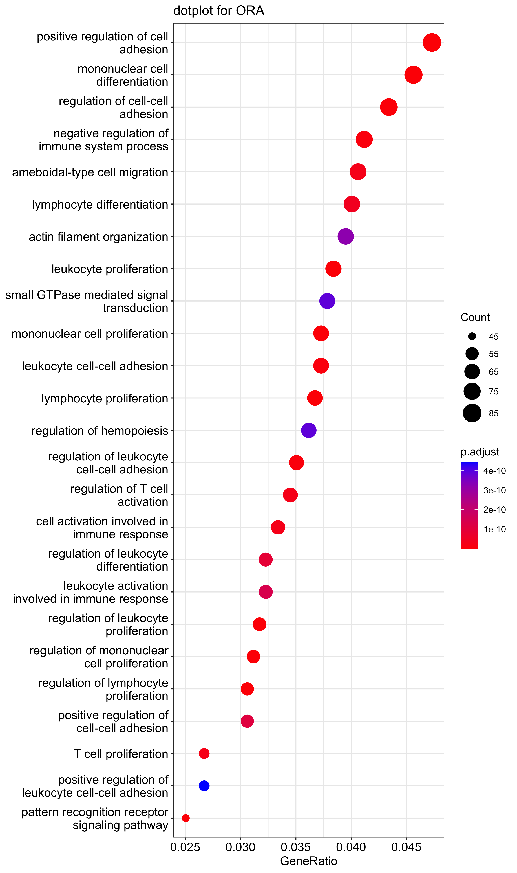
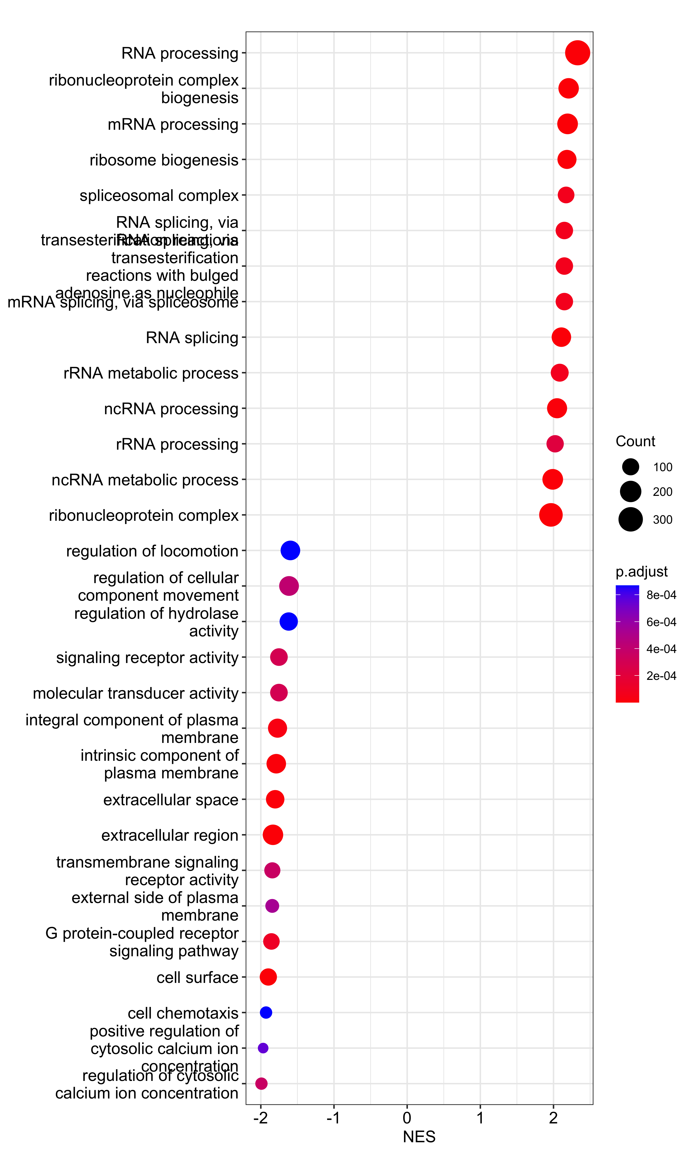
ORA
GSEA
Notes:
Explain the difficulty of interpreting the NES x axis

Slide 75
Differential expression analysis for RNAseq
Schurch NJ, et al, How many biological replicates are needed in an RNA-seq experiment and which differential expression tool should you use? RNA. 2016 Jun;22(6):839-51.
https://doi.org/10.1261/rna.053959.115
Seyednasrollah, F, A Laiho, and LA Elo. 2015. “Comparison of Software Packages for Detecting Differential Expression in RNA-Seq Studies.” Brief Bioinform 2013; 1 (16): 59. https://doi.org/10.1093/bib/bbt086.
Love, M, W Huber, and S Anders. 2014. “Moderated Estimation of Fold Change and Dispersion for RNA-Seq Data with DESeq2.” Genome Biology 15 (5): 550–58.
https://doi.org/10.1186/s13059-014-0550-8.
Van den Berge, Koen et al. “RNA Sequencing Data: Hitchhiker’s Guide to Expression Analysis.” Annual Review of Biomedical Data Science 2 (July): 139–73.
https://doi.org/10.1146/annurev-biodatasci-072018-021255.
G. Grolemund and H. Wickham « R for data science » O’Reilly 2017 Jan https://r4ds.had.co.nz/index.html

Slide 76

Global workflow

